Slide 1
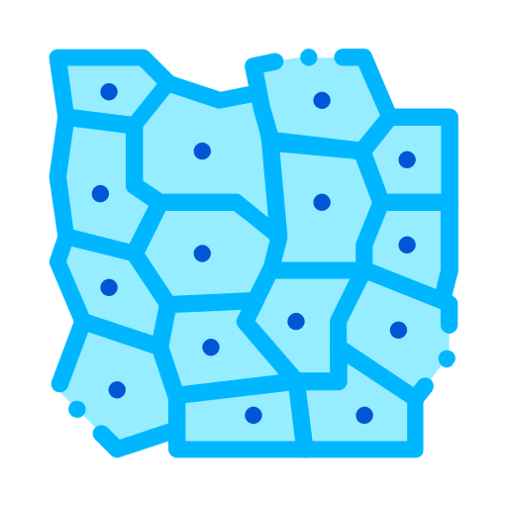
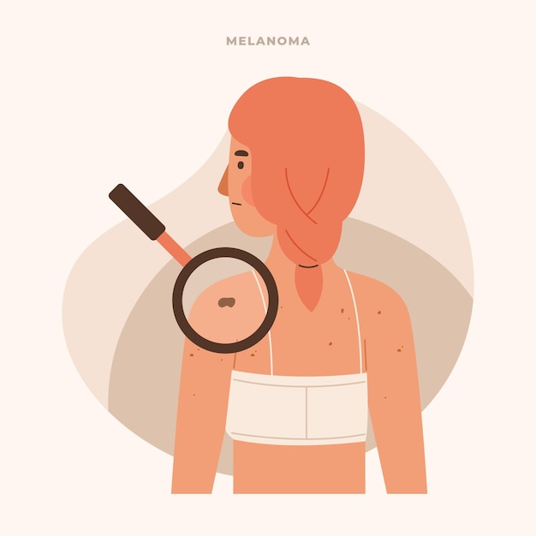
SKIN DISEASE DIAGNOSIS
Advanced Skin Disease Diagnosis leveraging image processing

Slide 2

INTRODUCTION
The Advanced Skin Disease Diagnosis project is a user-friendly tool designed to detect and analyze skin diseases.
Users can upload images of their skin, which are processed using OpenCV to highlight affected areas.
A Logistic Regression model predicts the type of skin disease with an accuracy of 77%.
The system offers an accessible way for users to monitor their skin health and take timely action.
This project combines advanced image processing and machine learning for effective skin disease diagnosis.

Slide 3
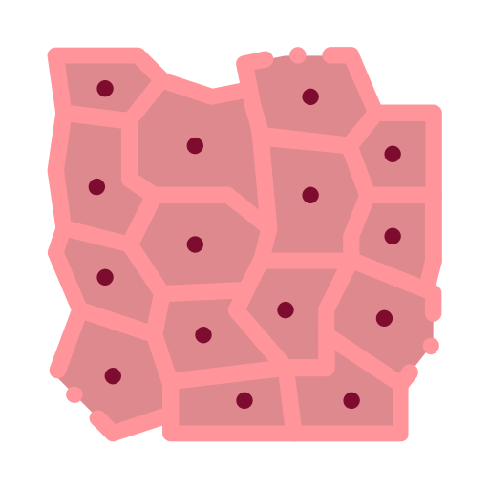
PROJECT OVERVIEW
CREATE A NEW USER ACCOUNT to access the application and its features.
LOGIN WITH YOUR USERNAME AND PASSWORD for secure, personalized access.
02
UPLOAD IMAGES OF SKIN for diagnosis, allowing the system to analyze and identify potential disease areas.
DIAGNOSIS RESULTS are displayed alongside the uploaded image on the profile page
NAVIGATE THE HOME, LOGIN, AND PROFILE PAGES easily with a user-friendly interface

Slide 4
MILESTONE
01
02
03
Set up Home, Login, and Signup Pages
Created easy-to-navigate pages that let users sign up and log
Learn and Experiment with OpenCV
Gained skills in using OpenCV for image processing
Implement Image Upload and Processing in UI
Designed a profile page where users can upload skin images. Integrated OpenCV to analyze these images
Implemented ML Models for Disease Prediction
04
Integrated the Logistic Regression model into the profile page to predict the disease from the user's uploaded image

Slide 5
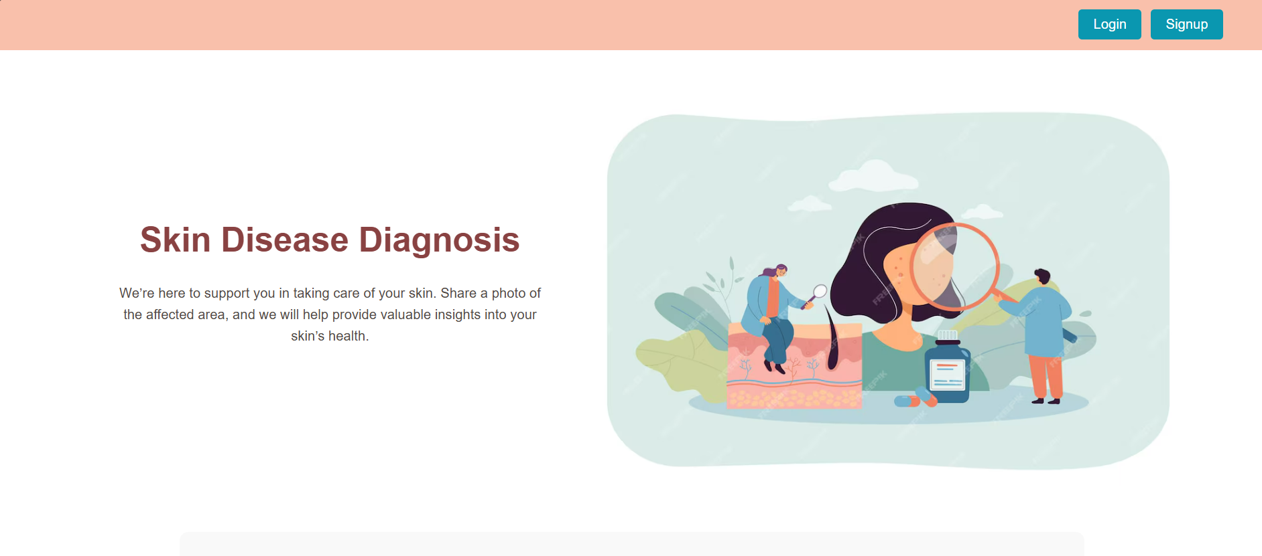
HOME PAGE
Login button for users to easily access the account.
Signup button users to easily create an account

Slide 6
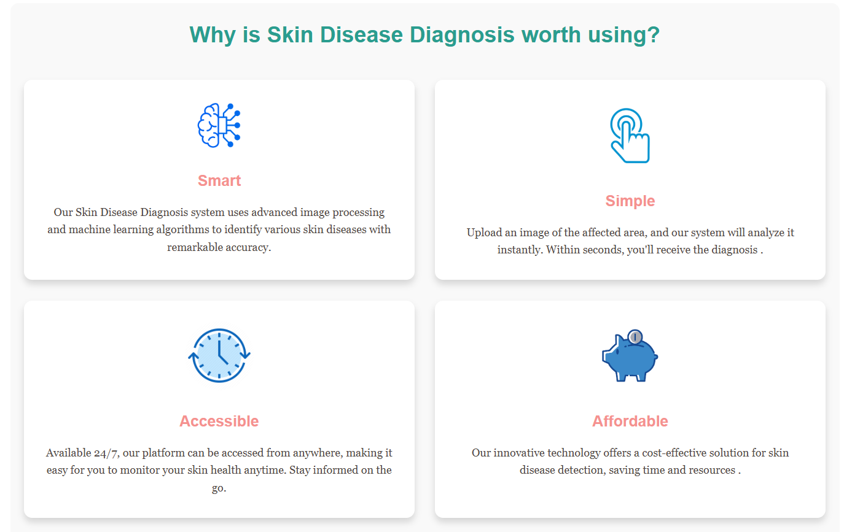

Slide 7
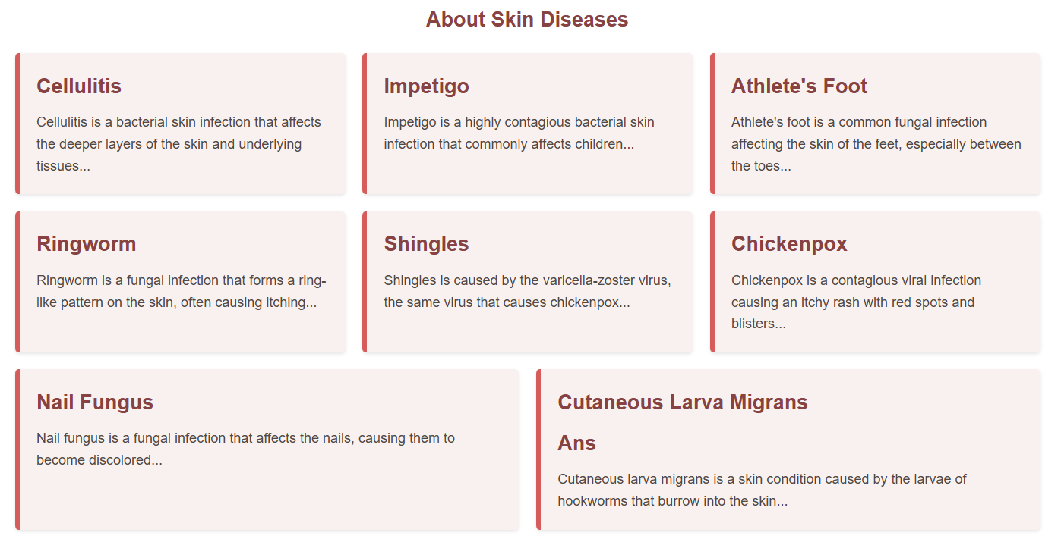
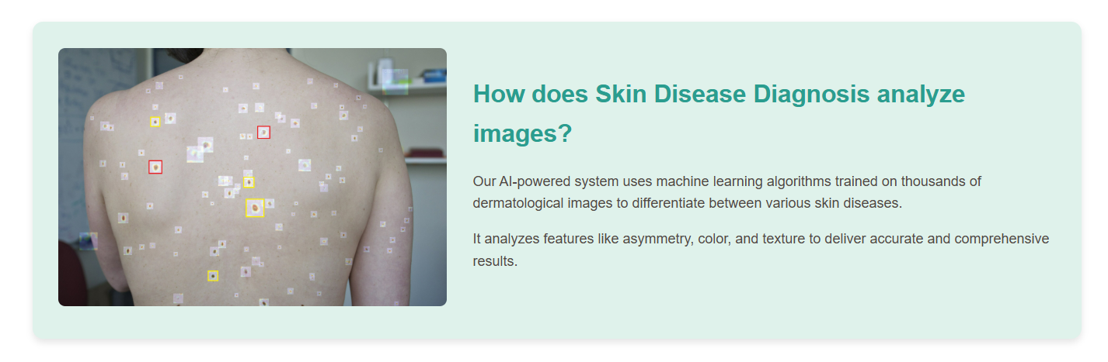
Some information about the skin disease the model was trained on.
Some information on how the model analyses the image.

Slide 8

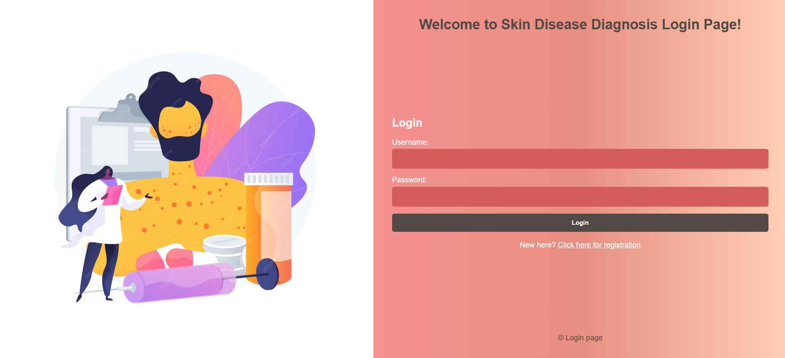
LOGIN PAGE
Users can enter their username
Users can enter their password
A button to submit the login form
Link to the signup page

Slide 9

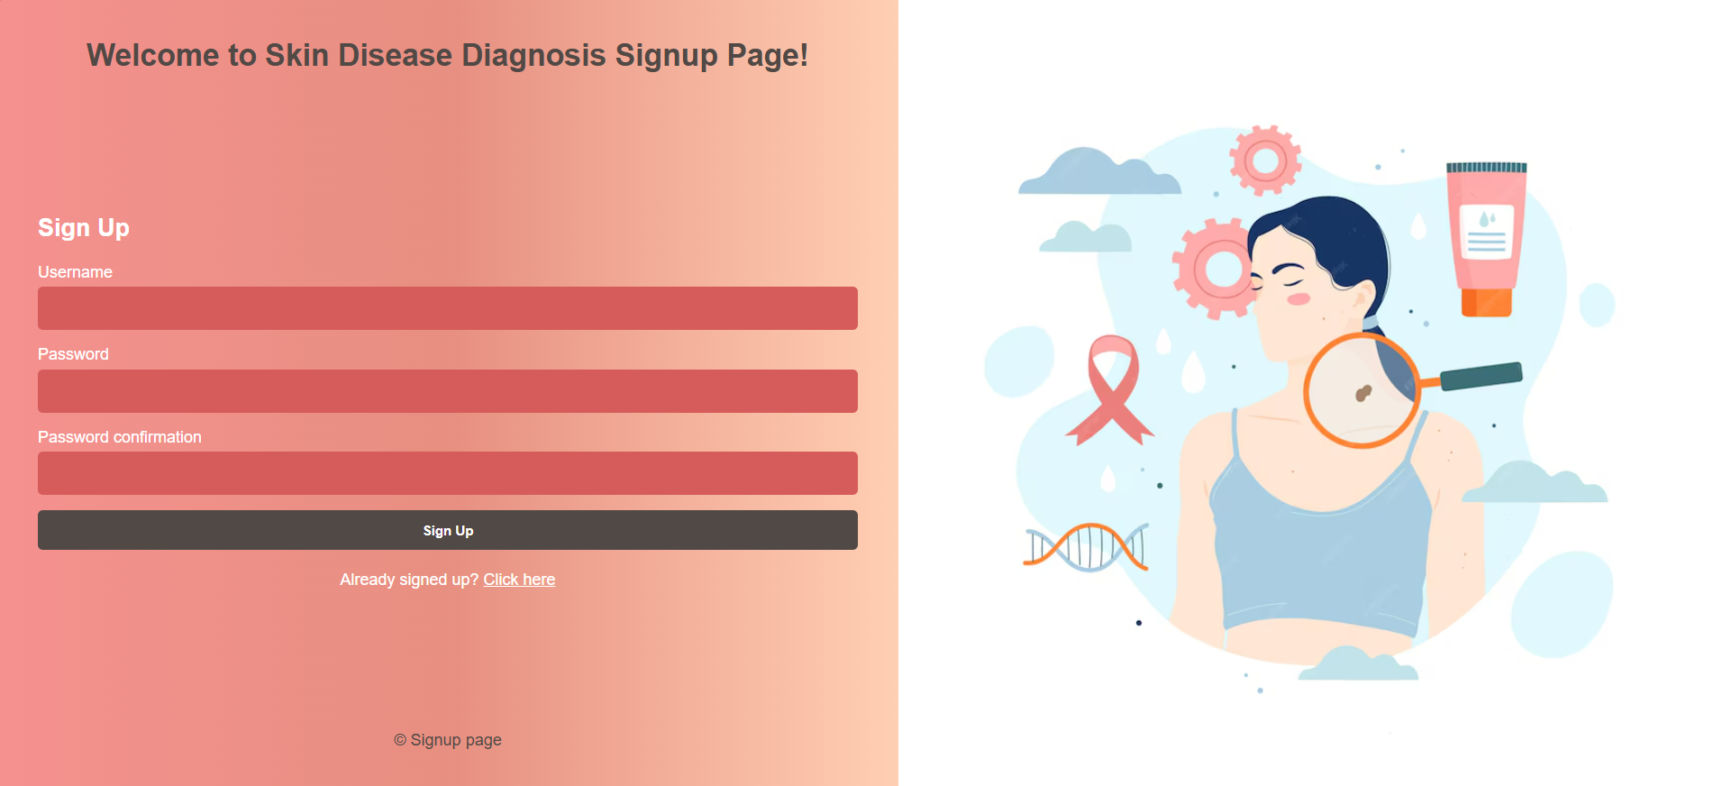
SIGNUP PAGE
users to enter their information, such as username, password, and password confirmation.
A button to submit the form and create the account.
Link to the login page for users who already have an account.

Slide 10
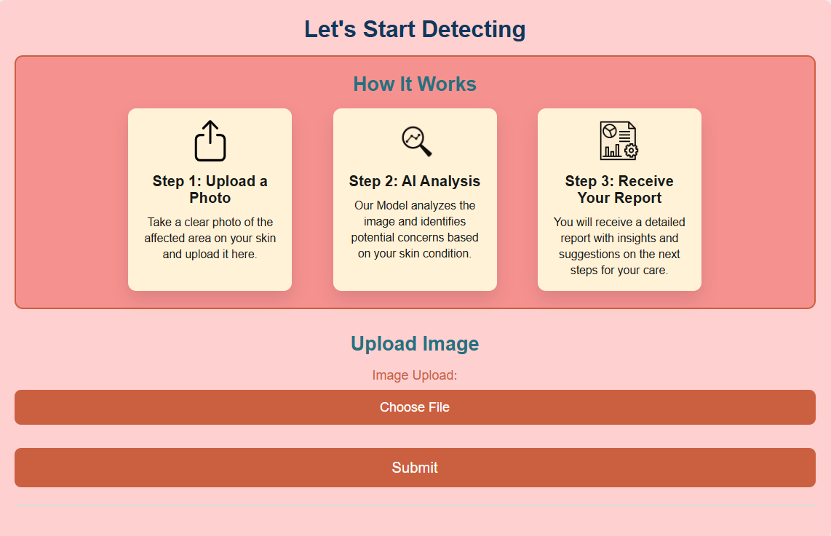
PROFILE PAGE
A Section explaining the users how it works
An input field for users to upload an image of their skin area for analysis.
A button to submit the image for processing.

Slide 11
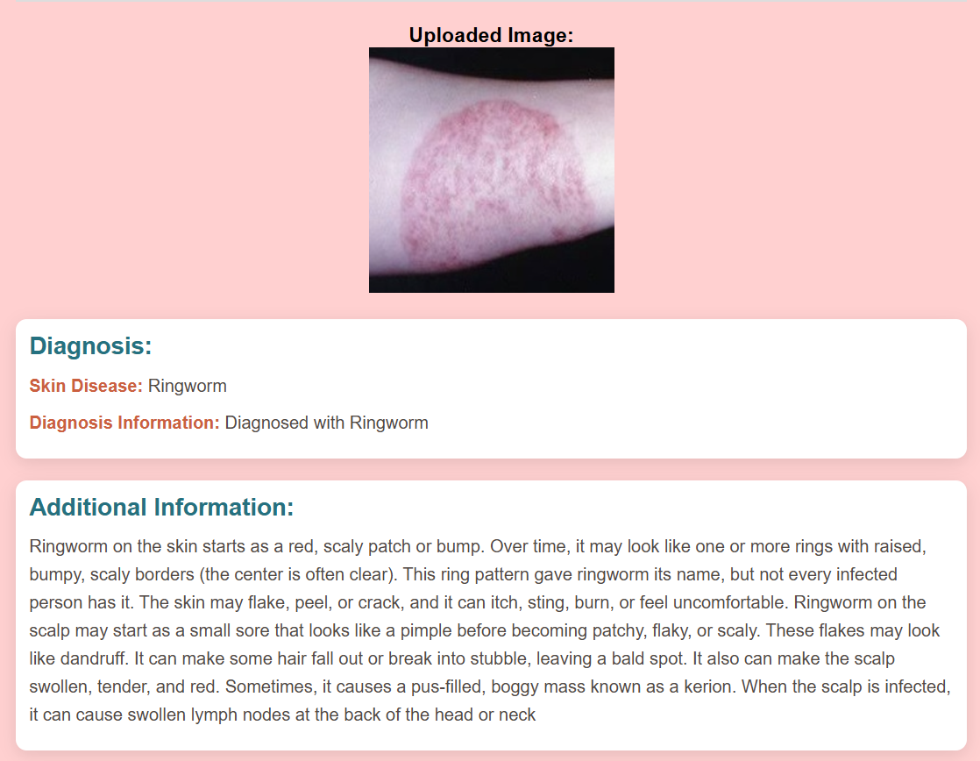
Shows the original uploaded image, allowing the user to confirm the image they submitted.
Displays the Diagnosis of the uploaded image
Some Additional information about the disease

Slide 12
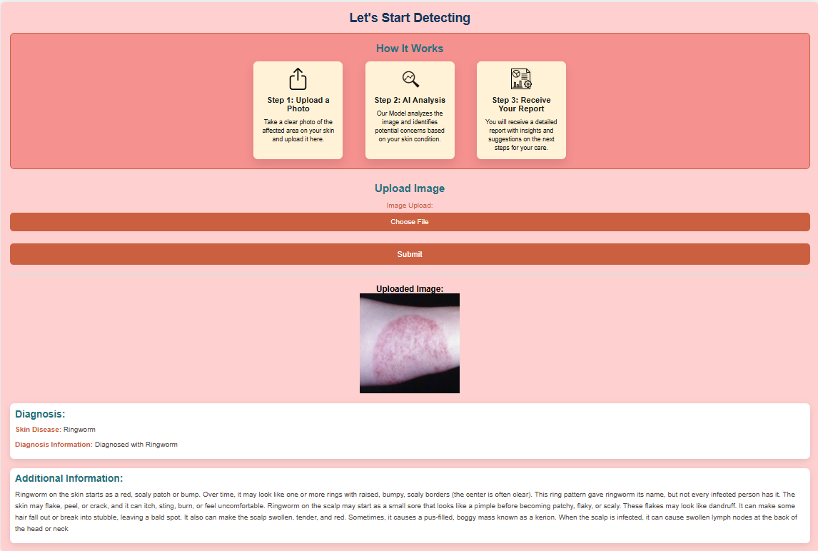

Slide 13
Model Training Process
01
Data Preparation:
Images from eight skin disease categories (e.g., Cellulitis, Impetigo…) were resized to `64x64` pixels, flattened, normalized, and standardized using `StandardScaler`
02
Model Training:
Tested models like Decision Trees, Random Forests, SVM, and Logistic Regression.
Logistic Regression was chosen for its simplicity and accuracy.
03
Evaluation:
Achieved 77% accuracy on the testing set.
Generated a classification report to evaluate precision and recall for each disease
Integration:
04
The trained model was saved as ‘joblib’ file.
Integrated it into the `profile’ page, where uploaded images are preprocessed and passed to the model for prediction.

Slide 14
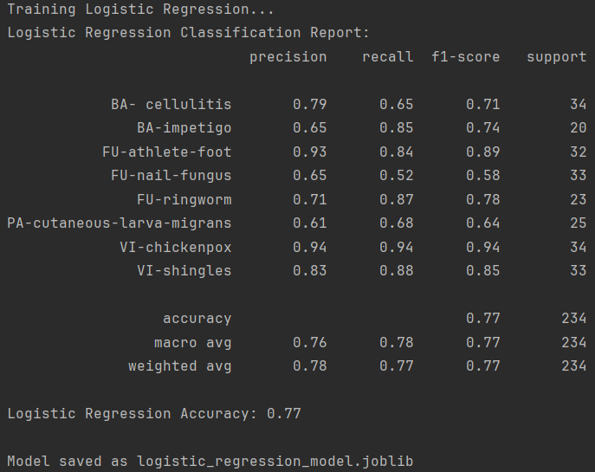
Generated a classification report to evaluate precision and recall for each disease
Achieved 77% accuracy on the testing set
Model was saved as ‘joblib’ file

Slide 15
Some More Models
Models | Accuracy
Ridge Classifier | 0.76
Random Forest Classifier | 0.75
Extra Trees Classifier | 0.73
XGBoost | 0.72
Gradient Boosting Classifier | 0.71
Linear Discriminant Analysis | 0.70
Voting Classifier | 0.69
Bagging Classifier | 0.63
Passive Aggressive Classifier | 0.62
SGD Classifier | 0.59
Decision Tree Classifier | 0.55
Naive Bayes | 0.30
MLP Classifier | 0.12

Slide 16
CONCLUSION
The Advanced Skin Disease Diagnosis project is a practical tool that combines image processing and machine learning to help users detect skin diseases.
Users can make an account, log in, and upload a picture of their skin.
The application provides a user-friendly interface for uploading images and viewing results, making it easy to monitor skin health.
This project promotes early detection and proactive care, offering an accessible solution for users to take charge of their well-being

Slide 17

Done By:
LAASVITHA YEADOTI

Slide 18
THANK YOU

